Slide 1
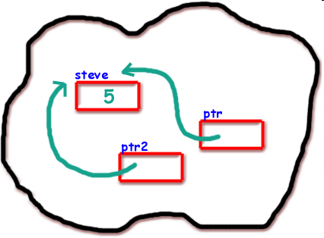
‘*’ , ‘&’ → Pointers In C

Slide 2
About me
Sriram kumar . K
III rd year CSE
Email - Sri2k42002@yahoo.co.in

Slide 3
What is a Pointer ?

Slide 4
Who does a memory look like ?
Address Locations
X1000
X1004
X1008
X100c
x1010
X1000
X1001
X1002
X1003

Slide 5
Operators used in Pointers
*
Dereferencing
Address
&
(Value of)
(Address of)

Slide 6
Int i=3;
Address of ‘i’
Value of ‘i’
‘&i’
‘*i’
variable
i
3
(Value of i)
X1000 x1004 x1008 x100c x1010 x1014
Address of i
The value ‘3’ is saved in the memory location ‘x100c’

Slide 7
Syntax for pointers
(pointer type declaration)
type *identifier ;
Example
Char *cp ;
Int *ip ;
Double *dp ;

Slide 8
Pointer Assignment
Int i = 1 , *ip ; //pointer declaration
ip = &i ; //pointer assignment
*ip = 3 ; //pointer assignment

Slide 9

Pointer Arithmetic
Lets take this example program
#include<stdio.h>
Void main()
{
Int a [5]={1,2,3,4,5} , b , *pt ;
pt = &a[0];
pt = pt + 4 ;
b=a[0] ;
b+=4 ;
}
b = 1
b=1+4
b= 5
a[0]
a[1]
a[2]
a[3]
a[4]
X1000 x1004 x1008 x100c x1010
pt
a[0]
a[1]
a[2]
a[3]
a[4]
b
X1000 x1004 x1008 x100c x1010

Slide 10
Lets Take an Example and See how pointers work
#include<stdio.h>
Void main()
{
Int i=3;
Int *j;
j=&i;
Printf(“i=%d”i);
Printf(“*j=%d”*j);
}

Slide 11
Int i=3;
Int *j;
j = &i;
Create an integer variable ‘i’ and initialize it to 3
Create a pointer variable ‘j’- create value of ‘j’
Initialize the pointer value of ‘j’ to the address of ‘i’
variables
Int *j
Int i
Memory
3
x100c
X1000 x1004 x1008 x100c x1010 x1014

Slide 12
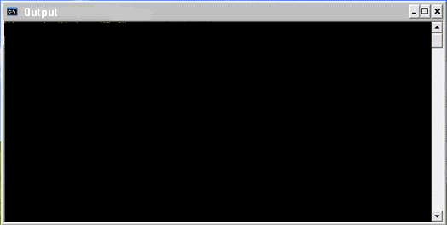
Output screen
Printf(“i=%d” i);
Printf(“i=%d” i);
Printf(“*j=%d” *j);
Printf(“*j=%d” *j);
i=3
We know j=&i
So → *j=*(&i) value of (address of i)
(i.e.) value in address (x100c)
*j=3
variables
Int *j
Int i
Memory
3
3
x100c
X1000 x1004 x1008 x100c x1010 x1014

Slide 13
Predict the output of this code
Void main()
{
int num=10;
int* pnum=NULL;
pnum = &num;
*pnum += 20;
printf("\nNumber = %d", num);
printf("\nPointer Number = %d", *pnum);
}

Slide 14
Number = 10
Pointer Number = 30

Slide 15
Work to your Brain
int a[10] = {1,2,3,4,5,6,7,8,9,12} ,*p, *q , i;
p = &a[2];
q = &a[5];
i = *q - *p;
Printf(“The value of i is %d” i );
i = *p - *q;
Printf(“The value of i is %d” i );
a[2] = a[5] = 0;
Printf(“The value of i is %d” i );

Slide 16
The value of i is 3
The value of i is -3
The value of i is 0

Slide 17
Work to your Brain
int a[10] = { 2,3,4,5,6,7,8,9,1,0 }, *p, *q;
p = &a[2];
q = p + 3;
p = q – 1;
p+ + ;
Printf(“The value of p and q are : %d , %d” *p,*q);

Slide 18
The value of p and q are : 7 , 7

Slide 19
Work to your Brain
int main()
{
int x[2]={1,2},y[2]={3,4};
int small,big;
small=&x[0];
big=&y[0];
min_max(&small,&big);
printf(“small%d big%d",*small,*big);
return 0;
}
min_max(int *a,int *b)
{
a++;
b++;
return (*a,*b);
}

Slide 20
Small 2 big 4

Slide 21


Slide 22


